Slide 1
A Framework for Partial Payments
Dave Schafer
Anum Goel

Slide 2
What We’re Trying to Do
Define a way for partial payment functionality to be exposed to front end users.
Partial payments are supported on the backend
This functionality for front end users is not yet defined in Civi core
There are a lot of challenges in doing this
Is there an alternative
How has BOT dealt with this issue

Slide 3
A long time ago in a
galaxy far far
away…
Actually it was 2010
and CiviCRM 3.3

Slide 4
Partial Payments for UMC Conferences
Our first Civi Implementation (yikes!)
Churches have remittances to pay to the conference
They don’t / can’t pay a fixed amount each month
BOT created a Civi component to provide payment entry for backend and front end users

Slide 5
AR Payment Component
Used the civi pledge data structure as an “Invoice” model
Created a custom UI for frontend and backend payment entry
Supported check or ACH payment methods
Custom table for recording the distribution of a contribution against multiple pledge records
Deployed in 2 UMC Conferences

Slide 6
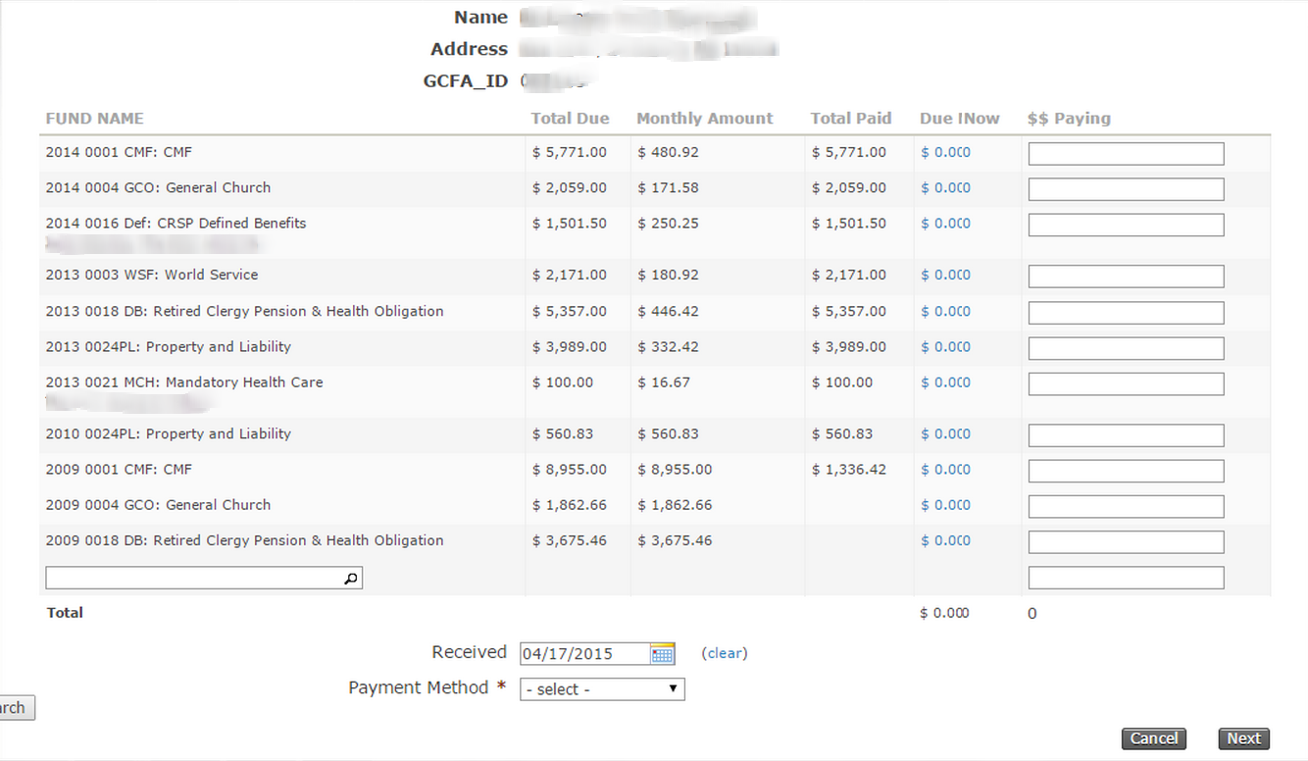

Slide 7
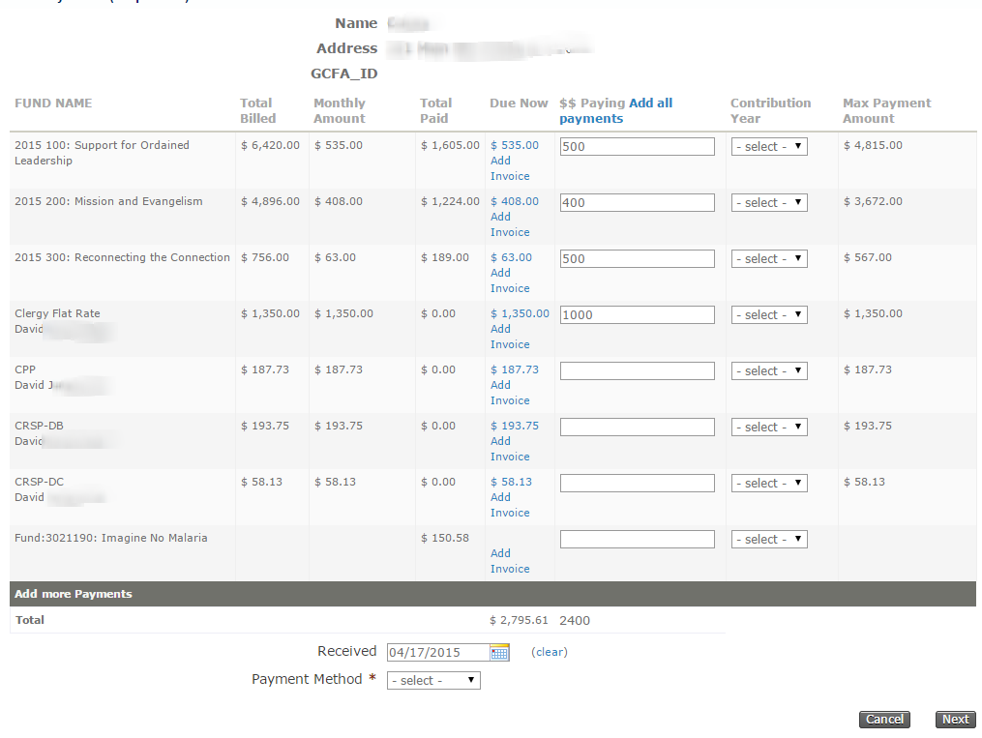

Slide 8
What Did We Learn?
The entire process is very client specific
The types of payments made
The rules for making payments
The information displayed to support the payment process
The UI components of the proces
And, during this time the partial payment structure in Civi was maturing - now what?

Slide 9
Let’s Use Core Partial Payments
4.5 introduced backend UI support for partial payments
No frontend features available
Works primarily for events
Works for contributions if special status rules are followed
Our first implementation for a camping organization.

Slide 10
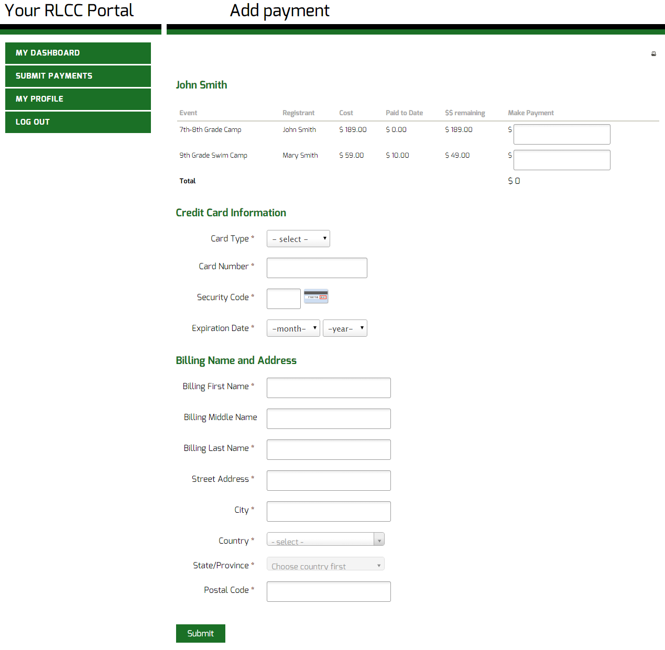
Notes:
http://dev.roundlake.vm-host.net/civicrm/roundlake/add/payment?reset=1

Slide 11
Technical Details

Slide 12
Approach
Two step process:
User Interface Extension
Partial Payment Extension
Why this approach?
Modular
Independent and flexible user interface

Slide 13
Web Page
User Interface Extension
Partial Payments Extension
Database
User
Clicks on ‘Make Payment’ link
Requests Payment Page
Requests Event Registration data for the logged in user
Renders form with payment options
Returns event registrations data
User fills payment details
Invoke payment processor
Create new financial transaction for total amount
process_partial_payments( )
Loop
Update contribution status
BAO::updateParticipantStatus()
BAO::recordAdditionalPayment ()
Returns updated records
Displays success message
Returns processed payments

Slide 14
User Interface Extension
Adds new ‘component’ in CiviCRM
Displays event registrations for the user and related contacts
Status of registrations – ‘Partially Paid’ or ‘Pending from pay later’
Uses default payment processor
Adds financial_trxn record for total amount being paid
Recommendation - Add validation for contribution id

Slide 15
Partial Payment Extension
Wrapper around the core function to create partial payments
Requires parameters to be passed in array
Payment processor parameters
Participant Information
Update status of contribution and participant record from ‘Pending from pay later’ to ‘Partially paid’ before processing
Returns the participant information array with a flag for success

Slide 16
Parameters
Payment processor parameters
Same parameters as used for doDirectPayment()
Participant information should be an associative array:
Key: participantID
Values:
‘cid’ (contactID)
‘contribution_id’ (contributionID)
‘payLater’ (PayLater flag)
‘partial_payment_pay’ (Partial Payment Amount)

Slide 17
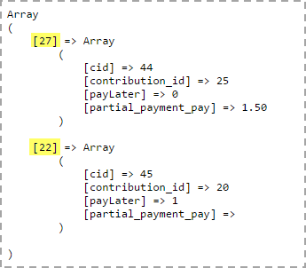
Example

Slide 18
Improvements
Define a viable error handling strategy in Partial Payment extension
Make the participant specific behavior optional
Determine if this can be extended to any “pending” contribution

Slide 19
Release
Development in CiviCRM 4.5.x
Tested successfully in CiviCRM 4.6.2
Released partial payment extension only
Download URL - https://github.com/backoffice/BOT-Partial-Payment-Extension/archive/master.zip

Slide 20
Thanks & Discussion
We hope this was helpful.
Where should we go from here?

